Slide 1
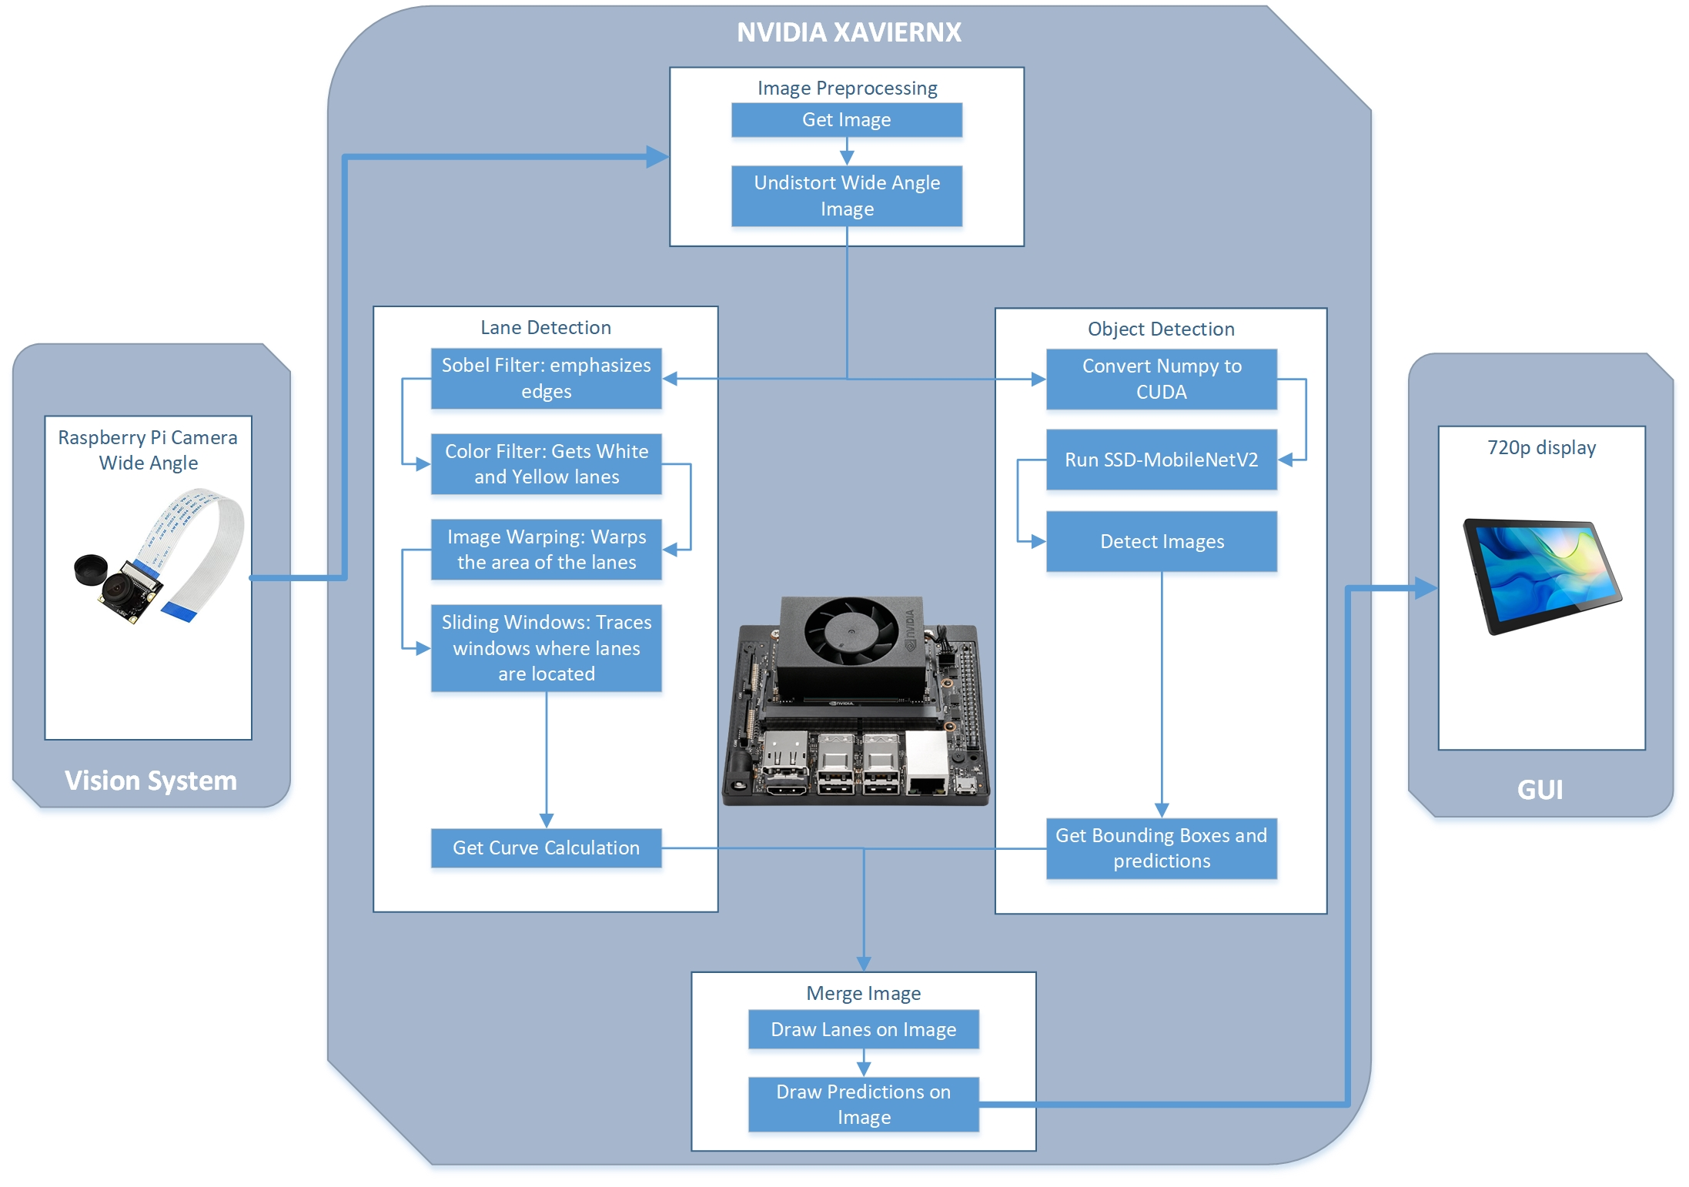
Driving Assistance System – On development
By: Luis Chachayma
PROJECT OVERVIEW
Currently in the market many cars have ADAS(Advanced driver-assistance systems) using cameras, sensors, computer vision systems and HMI (human machine interface) that increase the car and road safety. The problem is that those systems are not presented in old vehicles and a aftermarket implementation of those systems is expensive.
The project is to develop an affordable Driving Assistance System with the following considerations:
Lane Detection: Lane processing and display of the car deviation from the center of the lane.
Pedestrian Detection: Detection of the pedestrian crossing the lanes and running pedestrians.
Traffic signs detection: Recognition of traffic lights and Stop signs.
Alert System: Alert if there are unsafe conditions.
IMPLEMENTATION
Initially a NVIDIA Jetson Nano was used then upgraded to a Jetson Xavier NX.
For the image acquisition a 8MP Raspberry Camera is used.
Image Preprocessing: undistorted the Wide angle image obtained from the camera.
Lane Detection: Uses computer vision techniques to get the lanes and calculate the curvature of the road. The program was done using OpenCV and NumPy in python.
Object and traffic signs detection: Object detection done using SSD-MobileNetV2, the network was optimized with TensorRT to work more efficiently on the Jetson Xavier NX.
General Diagram of the system setup
Notes:
1

